Slide 1


From Calls to Crimes: Analyzing Public Safety Trends in Nashville
Jing You
6/17/2025
Notes:
“Good morning everyone. My name is Jing You, and I’m excited to present my Capstone project titled ‘From Calls to Crimes’.
This project analyzes public safety data in Nashville, and explores how it can help us better understand neighborhood trends and improve resource planning.
I’ve always been curious about how data connects to real life—and safety is something that affects every one of us.
So let’s dive in and see what the data can tell us.”

Slide 2
Why This Project Matters Exploring how public safety data helps us understand neighborhood trends and support smarter decision-making.
Public safety remains a growing concern in urban communities.
In Nashville, analyzing emergency call data provides valuable insights for city officials and community leaders to improve resource allocation and response strategies.
In this analysis, we explore:
Trends in emergency call volumes from 2018 to 2021 across all shifts
Growth and change patterns across ZIP codes and key neighborhoods
Shift-based and seasonal insights that reveal when and where calls are most frequent
Call type patterns and policy implications for priority response
Notes:
“So, why does this project matter?
Every police call represents a moment of concern—someone needing help.
By analyzing this data, we can uncover patterns that support smarter decisions, such as:
When are most calls made?
Where are the busiest zones?
Which calls are more likely to be real crimes?
My goal is to use this analysis to better support neighborhood safety strategies.”

Slide 3
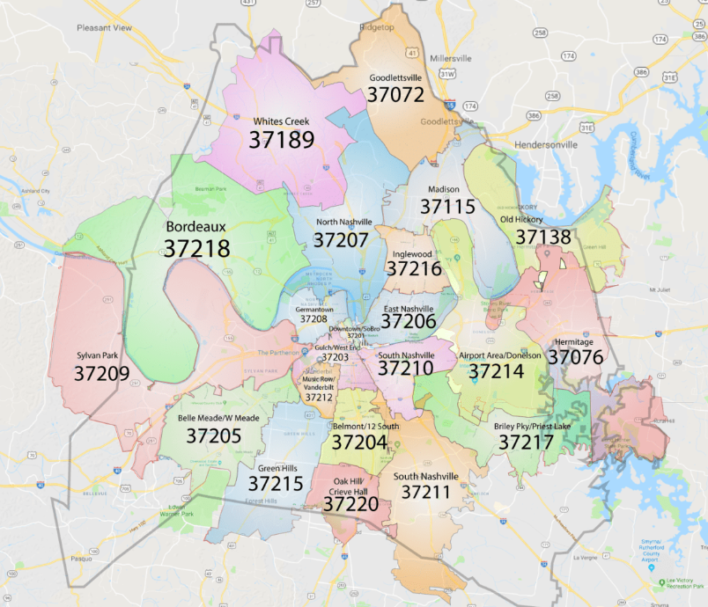
Nashville Key ZIP Code Map
Notes:
Slide 3 – Nashville Key ZIP Code Map
“Here is a map of key ZIP codes across Nashville.
This map helps us track geographic patterns in police activity.
Each ZIP code allows us to look at localized trends and compare changes over time.”
⏱️ 约 30秒

Slide 4
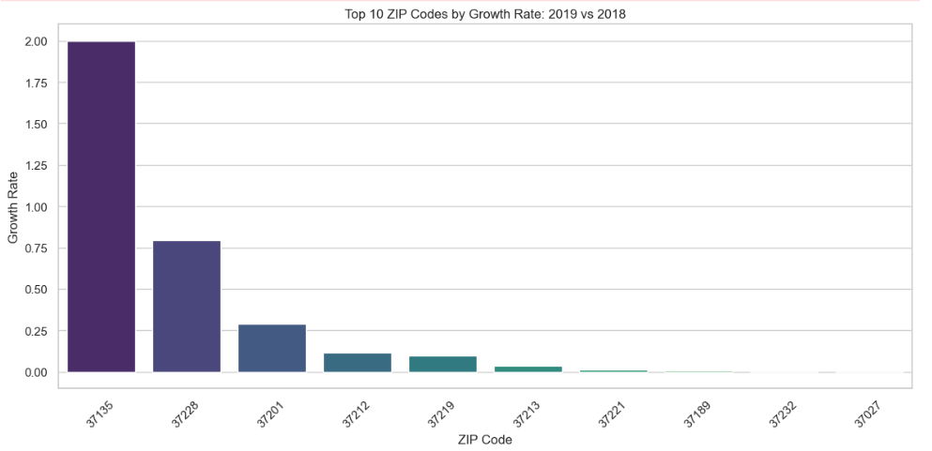
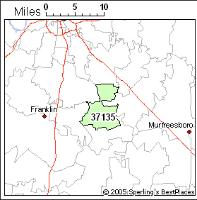
ZIP Code Growth Trends by Year: 2019 vs 2018
ZIP Code 37135 (Nolensville) experienced the highest growth rate in 2019, with an increase of +2.0, indicating strong regional development.
Notes:
“Between 2018 and 2019, the ZIP code 37135, which includes Nolensville, saw the highest growth in call volume—a +2.0 increase.
Based on my own research, I found that the population of Nolensville grew from around 8,199 in 2017 to 10,095 in 2019.
That’s an increase of about 11% per year for two consecutive years.
This rapid population growth likely contributed to more police calls, as more people means more activity, and more demand for public services.”

Slide 5
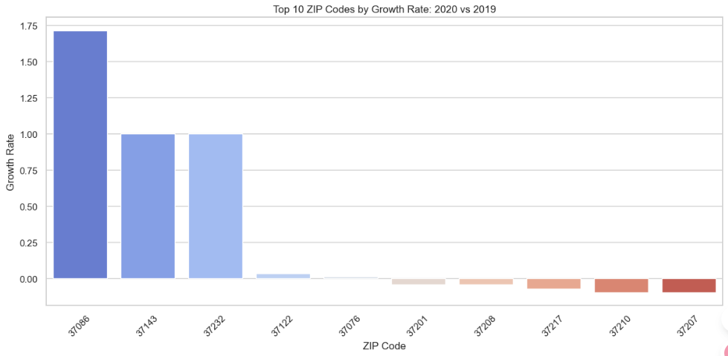
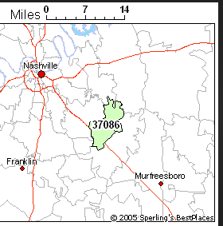
ZIP Code Growth Trends by Year: 2020 vs 2019
Significant Growth Observed: ZIP code 37086 experienced the highest increase in call volume in 2020, with a growth rate of over 1.7x compared to 2019.Other Notable Increases:
ZIP codes 37143 and 37232 also showed 100%+ growth, possibly due to population shifts, increased reporting, or specific local events.
Notes:
“In 2020, the ZIP code 37086, which covers the La Vergne area, experienced the largest increase in police call volume—1.7 times higher than the previous year.
Interestingly, according to population records, there was no significant population growth in this area during that time.
This leads me to believe that the spike may be related to behavioral changes caused by COVID-19, such as:
Increased stress and domestic tensions
More people staying at home
Higher sensitivity to suspicious activity
Even though COVID officially hit the U.S. in March 2020, it may have quickly affected how and why people made emergency calls.”

Slide 6
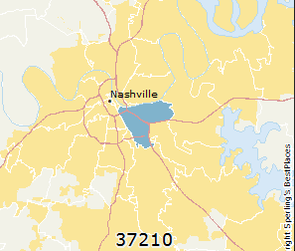
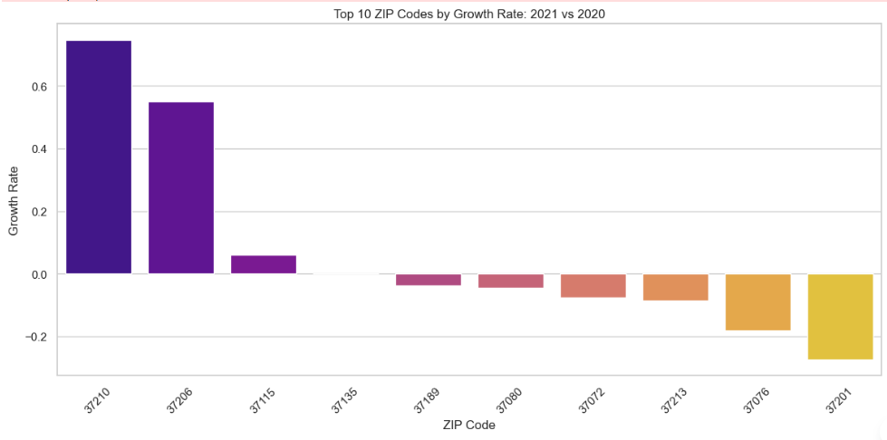
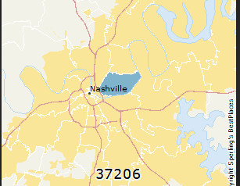
ZIP Code Growth Trends by Year:: 2021 vs 2020
Notes:
“In 2021, overall call volume started to level off in most areas.
But two ZIP codes—37210 and 37206—continued to show growth.
These two ZIPs are both part of East Nashville, which has become one of the city’s fastest-developing areas.
Based on this trend, I believe the increase in calls reflects rising population density, more urban activity, and possibly a higher level of community engagement or concerns about safety.
While most areas stabilized, East Nashville kept growing—both in people and in police-related activity.”

Slide 7
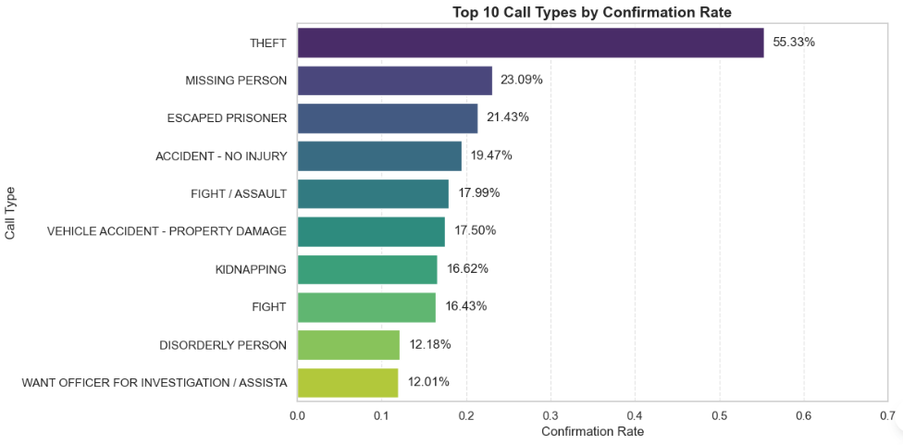
Theft ranks highest with a 55.33% confirmation rate. Missing Person (23.09%) comes next. Escaped Prisoner (21.43%) ranks third.
Which Call Types Are Most Likely to Be Confirmed as Real Crimes? arrests
Notes:
“Not every call ends in a crime report. But some types of calls are more likely to be confirmed.
For example, Theft had a confirmation rate of 55%, which is quite high.
Missing Person came second at 23%, and Escaped Prisoner ranked third.
This tells us which calls deserve more urgent attention, and which ones may not need as many resources.”

Slide 8
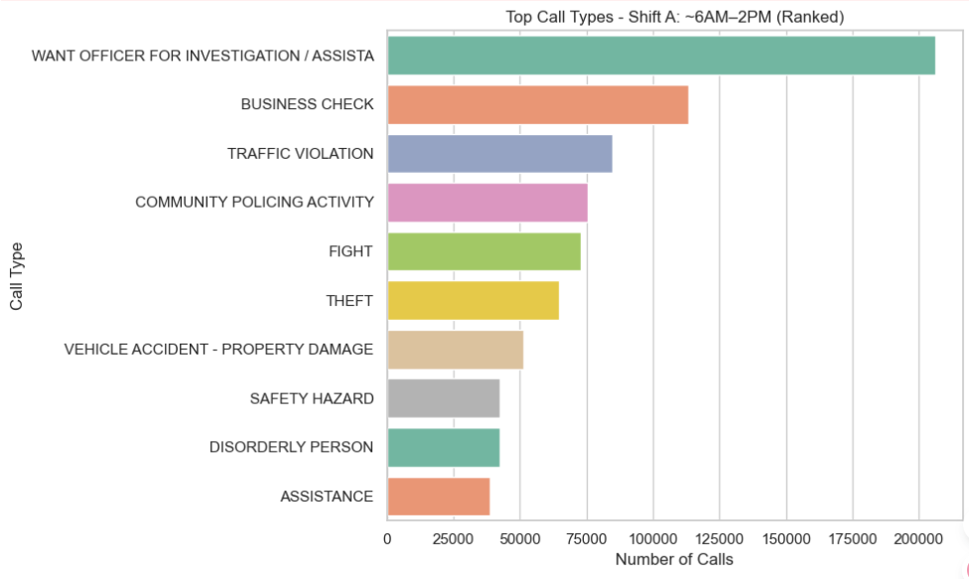
Top Call Types – Shift A (Day: 6AM–2PM)
🚨 Top Call Type:
“Want Officer for Investigation / Assistance” ranks first with over 200,000 calls, highlighting high demand for officer support during early hours.
🏢 Business Monitoring:
“Business Check” comes second, indicating a significant number of patrols and preventive checks aligned with business opening hours.
Notes:
“Let’s look at Shift A, which runs from 6AM to 2PM.
The most common call is ‘Want Officer for Investigation or Assistance’, with over 200,000 calls.
The second is ‘Business Check’, showing that officers spend a lot of time doing preventive patrols during the morning when businesses open.”

Slide 9
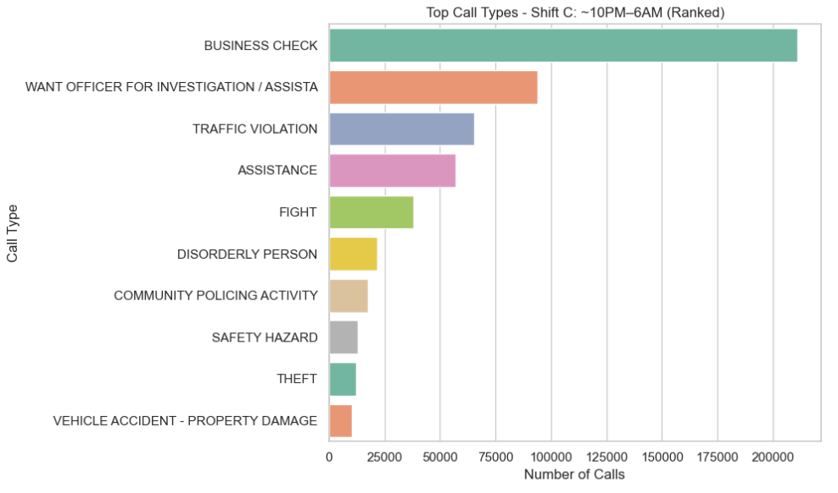
Top Call Types – Shift B (Evening: 2PM–10PM)
#1 Busienss Check, over 200,000 calls
# 2 Want Officer for Investigation / Assistance”
#3 Traffic Violation
Notes:
“Evening and night shifts show similar patterns.
In both, ‘Business Check’ is still the #1 call type.
This means officers continue to check businesses even at night.
Calls like ‘Want Officer’ and ‘Traffic Violation’ also remain frequent, showing the need for 24/7 support across the city.”

Slide 10
Top Call Types – Shift C (Night: 10PM–6AM)
#1 Busienss Check, over 200,000 calls
# 2 Want Officer for Investigation / Assistance”
#3 Traffic Violation
Notes:
Same resulte as last one

Slide 11
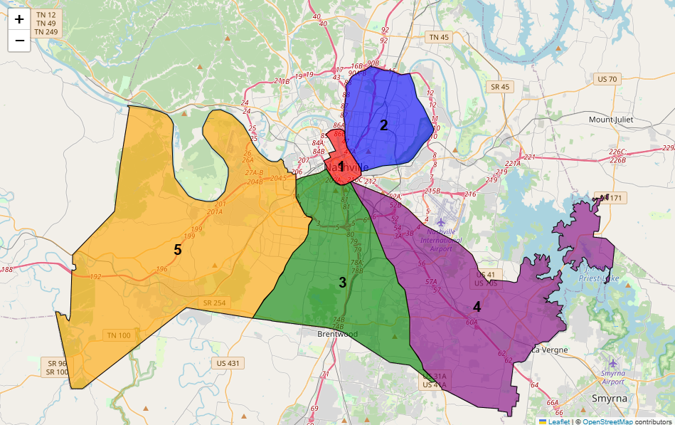
Geographic Distribution of Top 5 Police Precincts in Nashville (2018–2020)
These five precincts cover both urban and suburban areas, helping us analyze demographic and behavioral differences across regions.
Notes:
“These five precincts had the highest call volumes from 2018 to 2020.
They include both urban cores and fast-growing suburbs.
This comparison helps us understand how safety needs vary by population type and density.”

Slide 12
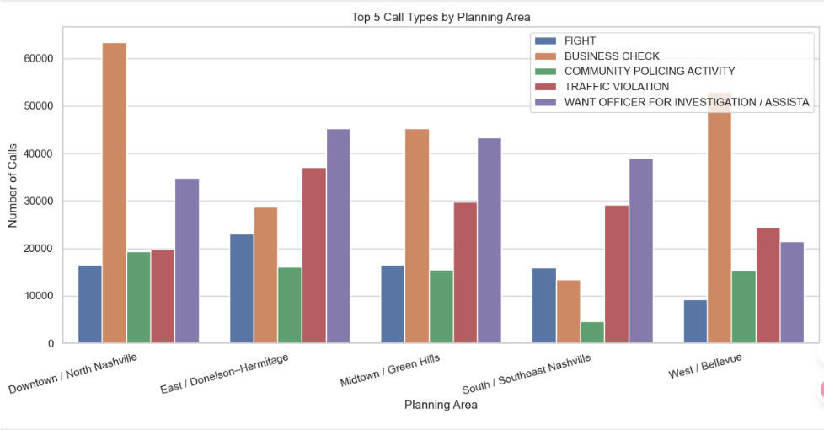
Business Zones Show Strong Demand for Officer Support
• Downtown and West Nashville report the highest Business Check calls—suggesting strong commercial security needs.
• “Want Officer for Investigation / Assistance” remains the most common call citywide.
Notes:
“Downtown and West Nashville showed the highest number of Business Check calls.
This likely reflects their role as commercial centers, where more patrolling is needed.
Meanwhile, the ‘Want Officer’ call remains the top request in every zone.”

Slide 13
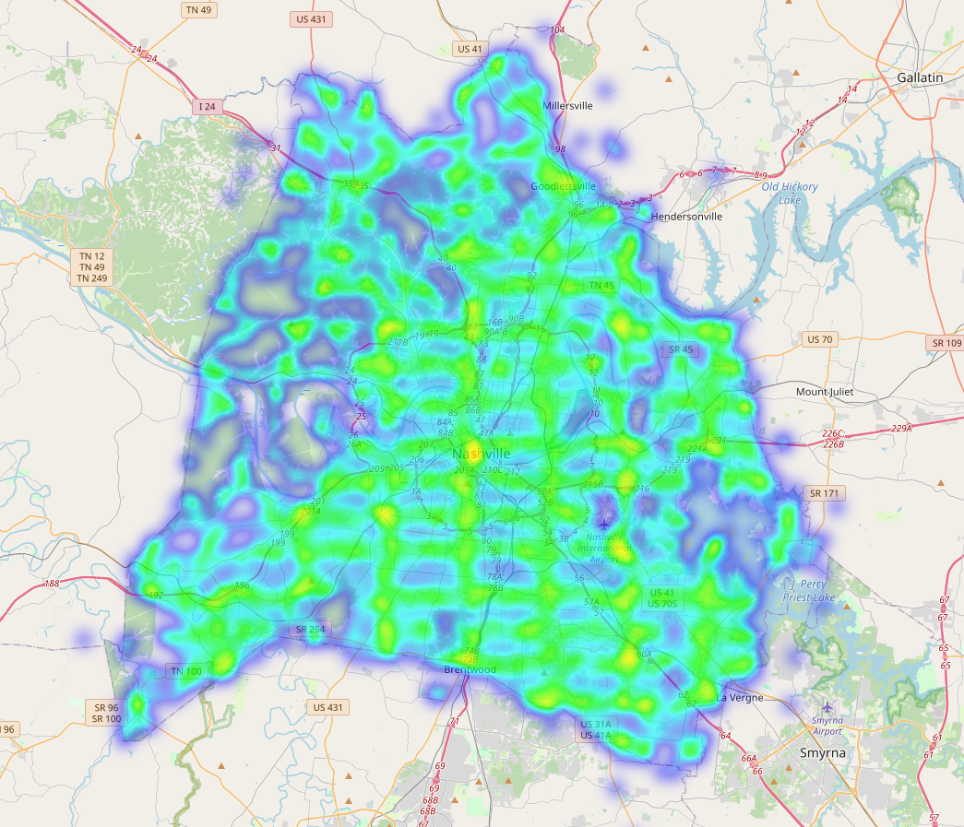
Heatmap of Police Service Calls in Nashville (2018–2020)
This heatmap shows where police activity was most concentrated across the city.
Areas with higher incident density are shown in red/yellow, indicating policing hotspots.
The downtown core, along with portions of East and South Nashville, exhibit the highest concentration of calls.
Notes:
“This heatmap shows areas with the most concentrated police activity.
Red and yellow areas are the hotspots, with the downtown core, East, and South Nashville being the most active.
This helps police understand where to focus patrols and respond faster.”

Slide 14
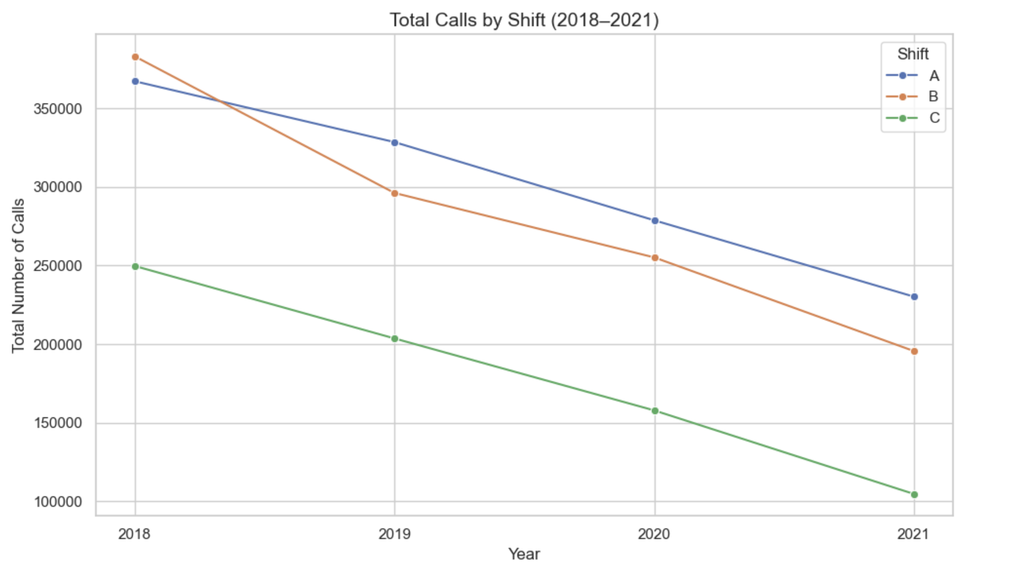
Trend of Total Calls by Shift (2018–2021)
The total number of calls across all three shifts (A, B, and C) shows a steady decline from 2018 to 2021.
Shift A consistently handled the highest volume of calls throughout the 4-year period.
Shift B experienced a sharp drop between 2018 and 2019, then a steady decline.
Shift C always had the lowest volume but followed a similar downward trend.
Notes:
“Over time, total call volume declined slightly from 2018 to 2021.
The day shift—Shift A—always had the highest number of calls.
Shifts B and C showed decreases, especially between 2018 and 2019.
This trend may reflect changing population behavior, more preventive efforts, or shifting reporting habits.”

Slide 15
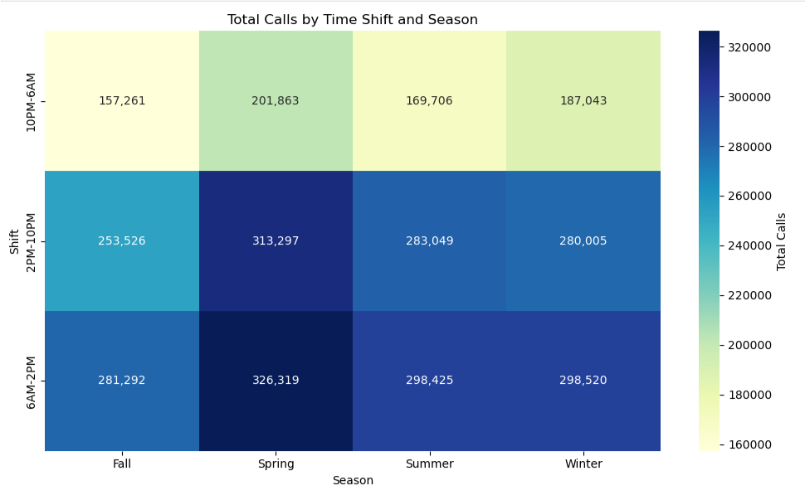
Seasonal policy Call Volume by Time of Day
🔸 Spring is the busiest season across all shifts.
🔸 6AM–2PM shift consistently receives the most calls in every season.
🔸 Night shift (10PM–6AM) always has the lowest volume, but still significant.
🔸 Fall and Winter show more balanced call volumes compared to Spring peaks.
Notes:
“Across all seasons, Spring was the busiest.
The day shift, again, handled the most calls.
Night shifts received the least, but still had a steady flow.
Fall and Winter were more balanced in volume.
This seasonal insight helps with staff scheduling and resource allocation.”

Slide 16
Final Insights & Recommendations
Insights
Recommendations
Call volumes steadily increased from 2018 to 2021, with 2020 showing the sharpest rise.
Spring and 6AM–2PM shifts consistently record the highest call volumes.
Theft, Missing Person, and Escaped Prisoner calls have the highest crime confirmation rates.
High-call ZIPs and precincts are located in fast-growing suburban and high-density urban areas.
Adjust patrol strategies to focus on Spring and day shifts.
Strengthen presence in high-volume areas such as 37135 and 37208.
Prioritize call types with high confirmation rates to optimize resource allocation.
Refine low-confirmation categories to reduce unnecessary response burden.
Notes:
“Let me summarize the main insights:
🔹 Calls increased over time, with 2020 as the peak year. 🔹 Spring and day shifts are the busiest periods. 🔹 The top confirmed crimes are Theft, Missing Person, and Escaped Prisoner. 🔹 High-call ZIPs and precincts are usually in fast-growing suburbs and urban cores.
Based on this, I recommend: ✅ Focus more patrols during spring and daytime ✅ Strengthen presence in ZIPs like 37135 and 37208 ✅ Prioritize high-confirmation calls ✅ Reevaluate low-confirmation call types to avoid resource waste
These actions can help improve both response speed and community safety.”

Slide 17
The end Questions?
THANK YOU

